Slide 1
Writing functions

Slide 2
Outline
In this lesson, we will:
Describe the idea of reusing code
Specifically, the issues with cutting and pasting code
Describe functions in C++
Look at how parameters can be used in the function body
We will look at implementing
A simple sine function
An absolute value function
The maximum of two parameters
A function that evaluates a cubic polynomial at a point
The maximum of three parameters
Look at how to use a function call within a function
See numerous examples

Slide 3
Using other code
To this point, we have described:
Function declarations, including
int main();
double cos( double x );
double pow( double x, double y );
One function definition:
int main() {
// Do something, if you want...
return 0;
}

Slide 4
Review of functions
Suppose we are authoring a piece of code that requires us to repeatedly calculate the absolute value of a local variable:
int main() {
double x{};
std::cout << "Enter a real number 'x': ";
std::cin >> x;
double y{3.14159265358979323846 - x };
if ( y < 0 ) {
y = -y;
}
std::cout << "|x - pi| = " << y << std::endl;
return 0;
}

Slide 5
Review of functions
Suppose we are authoring a piece of code that requires us repeatedly determine the maximum of two values:
int main() {
double x{};
std::cout << "Enter a number 'x': ";
std::cin >> x;
int y{};
std::cout << "Enter a number 'y': ";
std::cin >> y;
// Set z = max( x, y );
double z{x};
if ( y > z ) {
z = y;
}
std::cout << "max(x, y) = " << z << std::endl;
return 0;
}

Slide 6
Functions in C++
First, note that it is not immediately obvious what each of these code fragments are doing
You must examine the code, and deduce what is expected
Either that, or perhaps read the comments
You have to repeat this every time you want to perform these operations
What is the likelihood that each time,
you will not make a mistake (introduce a bug)

Slide 7
Functions in C++
If you find yourself performing a similar option more than once,
you are essentially cutting-and-pasting code
Questions:
What happens if you update one and forget the others?
What happens if you find a bug in one but forget you copied that code elsewhere before?

Slide 8
Functions in C++
A function is a means of authoring a piece of code to perform one operation once
Once it is tested, you and anyone else can repeatedly use it without ever having to worry about it
We have already seen numerous functions implemented in the C math library
You don’t care how they are implemented
Similarly, people won’t care how your functions are implemented

Slide 9
A simple sine function
Here is a function declaration for my sine function:
double my_sin( double x );
The function definition has a body that is executed when the function is called:
double my_sin( double x ) {
double result{ x - x*x*x/6.0 + x*x*x*x*x/120.0 };
return result;
}
function identifier or function name
return type
parameter and parameter type
local variable
function body
the returned value

Slide 10
A simple sine function
double my_sin( double x ) {
double result{ x - x*x*x/6.0
+ x*x*x*x*x/120.0 };
return result;
}
We can now use this:
#define _USE_MATH_DEFINES
#include <cmath>
#include <iostream>
// Function declarations
int main();
double my_sin( double x );
// Function definitions
int main() {
std::cout << my_sin( 0.4 ) << std::endl;
std::cout << std::sin( 0.4 ) << std::endl;
return 0;
}
// Insert function definition of my_sin here
Output:
0.389419
0.389418
argument

Slide 11
An absolute value function
Here is the declaration of the absolute value function:
double my_abs( double x );
The function definition has a body that is executed when the function is called:
double my_abs( double x ) {
double result{};
// Do something to calculate |x|
return result;
}

Slide 12
An absolute value function
For this function
double my_abs( double x );
The identifier x is called a parameter of the function
For different arguments, the output of the function may be different
That is, the identifier parameterizes the function
The scope of the parameter is restricted to the function body
Like a local variable, it can be accessed and modified
Its initial value is the value of the argument passed to the function in the corresponding location during the function call

Slide 13
An absolute value function
What is the expected return value?
If the parameter x >= 0,
the function should return x
If the parameter x < 0,
the function should return -x
Thus, one implementation of the function body is:
double my_abs( double x ) {
double result{};
if ( x >= 0 ) {
result = x;
} else {
result = -x;
}
return result;
}

Slide 14
An absolute value function
We can now use this function:
int main() {
std::cout << my_abs( -0.3 ) << std::endl;
std::cout << my_abs( 0.1 ) << std::endl;
std::cout << my_abs( -15.9 ) << std::endl;
return 0;
}

Slide 15
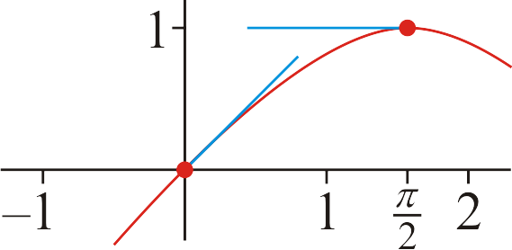
A function returning a polynomial
Suppose we have a cubic spline:
#define _USE_MATH_DEFINES
#include <cmath>
// Function declarations
double spline( double x );
int main();
// Function definitions
double spline( double x ) {
return 4.0*x*x/(M_PI*M_PI)*(
x - 4/M_PI*x - M_PI + 3.0
) + x;
}

Slide 16
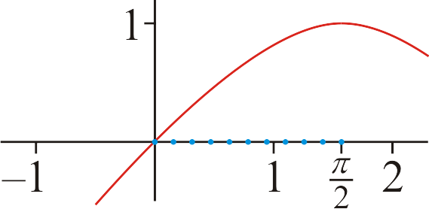
A function returning a polynomial
Inside main(), we can use this function:
int main() {
for ( int k{0}; k <= 10; ++k ) {
std::cout << M_PI_2*(0.1*k) << ",\t"
<< spline( M_PI_2*(0.1*k) ) << ",\t"
<< std::sin( M_PI_2*(0.1*k) ) << std::endl;
}
return 0;
}
Output:
0, 0, 0
0.15708, 0.155235, 0.156434
0.314159, 0.305062, 0.309017
0.471239, 0.446907, 0.45399
0.628319, 0.578195, 0.587785
0.785398, 0.69635, 0.707107
0.942478, 0.798796, 0.809017
1.09956, 0.88296, 0.891007
1.25664, 0.946265, 0.951057
1.41372, 0.986137, 0.987688
1.5708, 1, 1

Slide 17
A max function
Here is a different use of return:
// Function declarations
double max( double x, double y );
// Function definitions
double max( double x, double y ) {
if ( x >= y ) {
return x;
} else {
return y;
}
}

Slide 18
Functions used in algebraic expressions
Here we see a function call inside an argument to a function call:
#include <iostream>
// Function declarations
double my_abs( double x );
int main();
// Function definitions
int main() {
double z{};
std::cout << "Enter a real number: ";
std::cin >> z;
std::cout << my_abs( my_abs( z ) - 1.0 ) << std::endl;
return 0;
}

Slide 19
Functions used in algebraic expressions
We could use the absolute value function inside another function:
// Function declarations
double my_abs( double x );
double W( double x );
int main();
// Function definitions
double W( double x ) {
return my_abs( my_abs( 3.0*x ) - 3.0 );
}

Slide 20
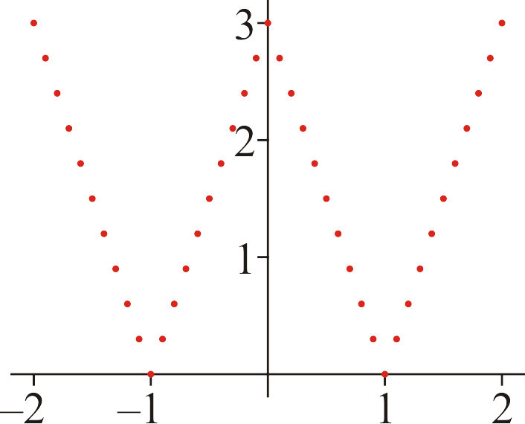
Functions used in algebraic expressions
Here we use the function W in a program:
#include <iostream>
// Function declarations
double abs( double x );
double W( double x );
int main();
// Function definitions
int main() {
for ( int k{-20}; k <= 20; ++k ) {
std::cout << 0.1*k << ", " << W( 0.1*k ) << std::endl;
}
}
// Include function definitions for my_abs and W

Slide 21
The maximum of three parameters
As the requirements for the function become more complex,
so do the implementations
// Function declaration
double max( double x, double y, double z );
// Function definition
double max( double x, double y, double z ) {
if ( (x >= y) && (x >= z) ) {
return x;
} else if ( y >= z ) {
return y;
} else {
return z;
}
}

Slide 22
The maximum of three parameters
Although, at times, perhaps,
other functions can be used to simplify the implementation
// Function declaration
double max( double x, double y, double z );
// Function definition
double max( double x, double y, double z ) {
return max( max( x, y ), z );
}

Slide 23
A factorial function
Anything you have authored in main() can also be part of a function
Consider this implementation of the factorial
// Function declaration
int factorial( int n );
// Function definition
int factorial( int n ) {
int result{1};
for ( int k{1}; k <= n; ++k ) {
result *= k;
}
return result;
}

Slide 24
Variations on the absolute value function
There are many equally valid ways of writing the same function:
double abs( double x ) {
double result{};
if ( x >= 0 ) {
result = x;
} else {
result = -x;
}
return result;
}
double abs( double x ) {
if ( x >= 0 ) {
return x;
} else {
return -x;
}
}
double abs( double x ) {
double result{x};
if ( result < 0 ) {
result = -result;
}
return result;
}
double abs( double x ) {
if ( x < 0 ) {
x = -x;
}
return x;
}

Slide 25
Variations on the maximum of two parameters
There are many equally valid ways of writing the same function:
double max( double x, double y ) {
if ( x >= y ) {
return x;
} else {
return y;
}
}
double max( double x , double y ) {
double result{x};
if ( result < y ) {
result = y;
}
return result;
}
double max( double x , double y ) {
if ( x < y ) {
x = y;
}
return x;
}

Slide 26
Variations on the maximum of three parameters
There are many equally valid ways of writing the same function:
double max( double x, double y, double z ) {
if ( (x >= y) && (x >= z) ) {
return x;
} else if ( y >= z ) {
return y;
} else {
return z;
}
}
double max( double x , double y , double z ) {
double result{x};
if ( result < y ) {
result = y;
}
if ( result < z ) {
result = z;
}
return result;
}
double max( double x , double y , double z ) {
if ( x < y ) {
x = y;
}
if ( x < z ) {
x = z;
}
return x;
}

Slide 27
Variations on the maximum of three parameters
There are many equally valid ways of writing the same function:
double max( double x, double y, double z ) {
if ( x >= y ) {
if ( x >= z ) {
return x;
} else {
return z;
}
} else {
if ( y >= z ) {
return y;
} else {
return z;
}
}
}

Slide 28
Example
Let’s write a function that solves a problem:
Let us write a function that returns the root of ax + b
Now, if
Note that we don’t care about the variable:
is the root of ay + b and aξ + b
Thus, the only information we need are the values of the coefficients

Slide 29
Example
Thus, a reasonable function declaration is:
// Function declarations
// - Find the root of ax + b where 'x' is the unknown
double linear_root( double a, double b );
The function implementation is:
// Function declarations
// linear_root
// Parameters:
// double a The coefficient of 'x'
// double b The constant coefficient
// Find the root of the linear polynomial ax + b
// - The equation ax + b = 0 <=> ax = -b
// <=> x = -b/a
double linear_root( double a, double b ) {
return -b/a;
}

Slide 30
Summary
Following this lesson, you now:
Understand how to author a function body
Know how to use and modify parameters inside the function body, just like local variables
Understand that there are multiple ways of implementing a function that satisfies the same requirements
Have an idea of how to start authoring functions based on the requirements of that function
Know that you can call one function from within another function
Have an idea that there are sometimes easier ways of implementing the same function
You may be able to deduce that more difficult implementations are not necessarily better…

Slide 31
References
[1] Cplusplus.com
http://www.cplusplus.com/reference/cmath/

Slide 32
Acknowledgments
None so far.

Slide 33
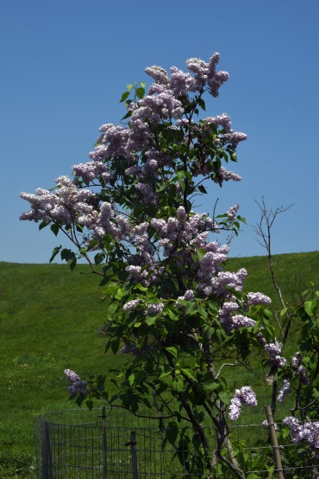
Colophon
These slides were prepared using the Georgia typeface. Mathematical equations use Times New Roman, and source code is presented using Consolas.
The photographs of lilacs in bloom appearing on the title slide and accenting the top of each other slide were taken at the Royal Botanical Gardens on May 27, 2018 by Douglas Wilhelm Harder. Please see
https://www.rbg.ca/
for more information.

Slide 34
Disclaimer
These slides are provided for the ece 150 Fundamentals of Programming course taught at the University of Waterloo. The material in it reflects the authors’ best judgment in light of the information available to them at the time of preparation. Any reliance on these course slides by any party for any other purpose are the responsibility of such parties. The authors accept no responsibility for damages, if any, suffered by any party as a result of decisions made or actions based on these course slides for any other purpose than that for which it was intended.

